Slide 1
EE406-UNDERGRADUATE PROJECT
Group 11-Indo-Lanka Power Grid Linkages: Evaluating Technical, Social, and Economical IMPACT
E/19/469 Fernando h.a.h.
E/19/110 Fernando W.R.A
E/19/411 Uthpala k.j.
Supervisors: prof. k.m. liyanage
Dr. u.s. navaratne
DR. k.r.m.n. Rathnayake

Slide 2
INTRODUCTION
The Indo-Lanka power grid linkage project has been under discussion for over a decade between India and Sri Lanka.
The project proposes a 500 MW HVDC double-line transmission system connecting Madurai in India to New Habarana in Sri Lanka.
India already has power interconnections with several neighboring countries, many of which have experienced significant impacts, both positive and negative economically, socially and politically.
Predicting the economic and social impacts on Sri Lanka due to this interconnection before its establishment could provide valuable insights.
This interconnection is important because of its stability and cost-effectiveness.
2

Slide 3
IDENTIFIED PROBLEM
What will happen to the existing power plants in Sri Lanka, and how they have been affected economically.
Energy importing restrains.
Forecasting impacts is essential to help Sri Lanka negotiate a better bilateral contract.
Ensures the interconnection benefits Sri Lanka while addressing potential risks effectively.
Designing the generator model of the interconnection and calculate benefits.

Slide 4


4
PROJECT AIM
This project investigates the technical, social, and economic impacts of interconnecting the Indo-Lanka power grids, assessing the effects on existing power plants in Sri Lanka and identifying and quantifying the drawbacks and benefits.
OBJECTIVES
Assess the effects on existing power plants in Sri Lanka.
Predict future energy demand considering economic and social factors.
Quantify the potential benefits and drawbacks of interconnection.
Model the generator system for interconnection.
Cost change due to uncertainty.

Slide 5
 | Weeks
 | Week 1-2 | Week 3-4 | Week 5-6 | Week 7-8 | Week 9-10 | Week 11-12 | Week 13-14
Activities
Literature Review
Data collection and forecasting model refinement
Operational and constraint impact analysis
Cross-border export feasibility study
Economic dispatch analysis
Deliverables
A summary of the literature review
Electricity forecasting model
Energy export opportunities and constraints
Economic dispatch analysis report
Final report

Slide 6
LITERATURE REVIEW
Citation | Summary
Fundamentals of Power System Economics Daniel Kirschen Goran Strbac University of Manchester Institute of Science & Technology (UMIST) | Methods for optimizing power generation and distribution to minimize costs while meeting demand. The financial feasibility of power projects, including investment decisions and return on investment calculations. Different pricing mechanisms for electricity, such as marginal cost pricing and tariff structures. The benefits and challenges of linking national grids, with case studies on inter-country power trade.
Cross-border Power Trading IN South Asia: A Techno Economic Rationale Priyantha Wijayatunga, D. Chattopadhyay and P. N. Fernando | The economic and reliability benefits of electricity trading among South Asian countries including Afghanistan, Bangladesh, Bhutan, India, Nepal, Pakistan, and Sri Lanka. Cross-border electricity trade to improve energy security, economic growth, and renewable energy integration. The complexities of linking national grids, including HVDC transmission, grid stability, and infrastructure development. The financial feasibility of interconnections using methods like Net Present Value (NPV) to determine long-term savings and profitability.
CEB statistical Digest Reports since 2005 | Data on GDP growth, employment, inflation, trade, demographics, education, healthcare, transportation, energy, urban projects, and environmental sustainability. Analyzes industry, tourism, finance, policy impacts, and future economic projections.

Slide 7
Submarine Cable System Market Worth $30.50 Billion, Globally, by 2030 - Exclusive Report by The Insight Partners | Submarine cable maintenance costs range from $10,000 to $50,000 per km per year, while repairs can cost $1 million to $5 million per incident. Key factors affecting costs include cable depth, location, natural risks, and operational expenses, with repair ships costing $35,000 to $100,000 per day.
Assessment of Socio-Economic Impacts of CBET in Bangladesh | The Indo-Bangladesh Grid Linkage enhances electricity access for various sectors, benefiting vulnerable groups like hospitals and schools. It fosters economic growth by creating jobs, advancing agriculture and garment production, and empowering women. The project promotes poverty reduction, sustainable development, and equitable energy access, boosting productivity in critical sectors like healthcare and education. The linkage faces risks such as reliance on imports, geopolitical tensions, environmental concerns, and infrastructure issues, which affect long-term sustainability.
Long Term Generation Expansion Plan 2022-2041 Ceylon Electricity Board | Outlines Sri Lanka’s electricity generation plan for 2022-2041. Plans for reliable power supply and future demand. Proposes new power plants and transmission upgrades. Aims to reduce fossil fuel dependency and ensure energy security.

Slide 8

8
PROJECT PLAN
Literature review
Data collection
Forecasting MCP
Research papers, self learning
IEX and PUCSL Data
Forecasting MCP with IEX data
Quantify the Economical Impact
Technical and Economical analysis
According to the uncertainty of the link we have calculated new unit cost for the link considering different scenarios.
Economical Dispatch of the Interconnection and the existing power plants in Sri Lanka.

Slide 9
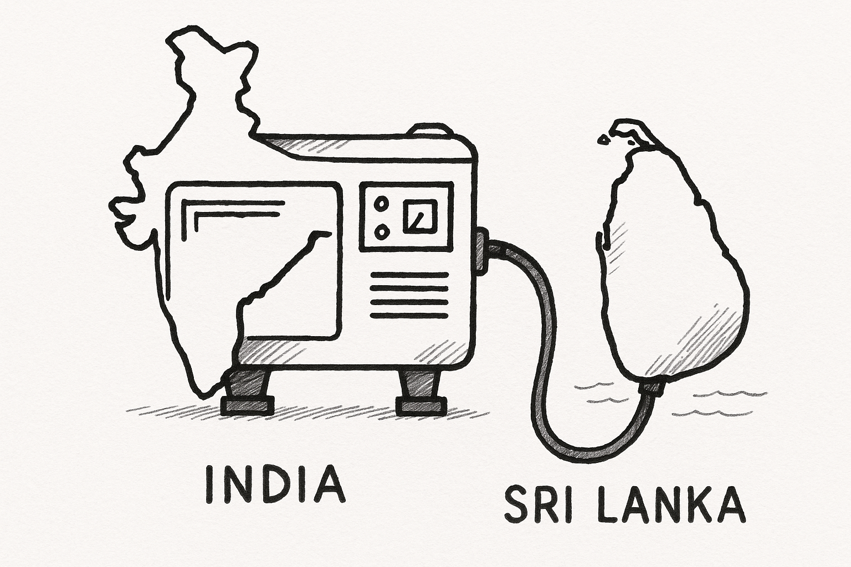
Methodology
9
Analyzing the unavailability of the Indian link using historical IEX data
Conducting an economical dispatch: with and without the Indian Link
Calculate the new Cost of the Indian Link Based on its unavailability.
Identify the local power plants that will be affected, Calculated their losses and profit for Sri Lanka
Update the Cost Table Considering Various Scenarios.

Slide 10
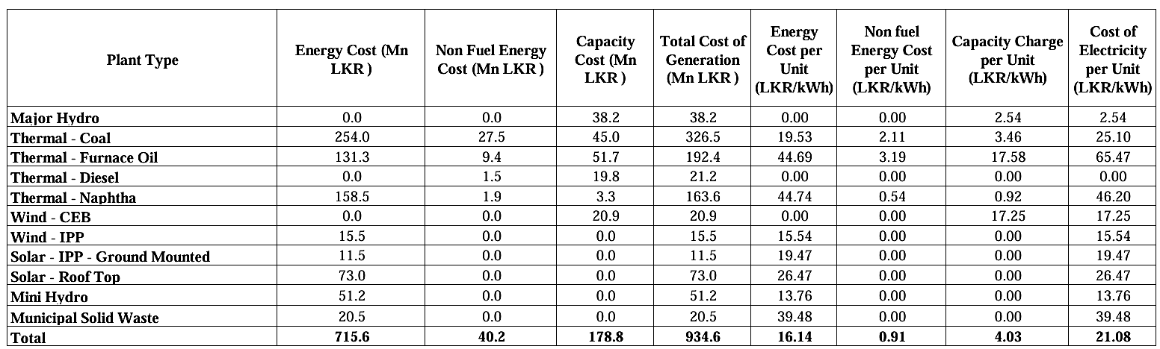
Most power plants in the system are affected by the Indian grid connection.
We identified the most vulnerable power plants, focusing on all the local power plants
Sri Lanka’s System Control Centre currently uses hourly scheduling intervals for generation dispatch
Notes:
This table shows the average unit price of each type of power plant in Sri Lanka. Most of the power plants are affected by the Indian link since the cost of Indian power is lower. The Indian energy market operates in 15-minute time intervals, whereas economic dispatch in Sri Lanka is usually done considering on an hourly basis (hourly economic dispatch).

Slide 11
Indian Link is Available Date : 25 Jan 2024 Time: 00.00-00.15am
Indian Link is Unavailable
Date : 25 Jan 2024 Time: 17.00-17.15am
Notes:
this 1st graph indicate a time period where we can exchange power since supply demand curve intersect. But 2nd graph do not intersect. Accordingly we can see that Link was available in the mid night but not in the evening

Slide 12
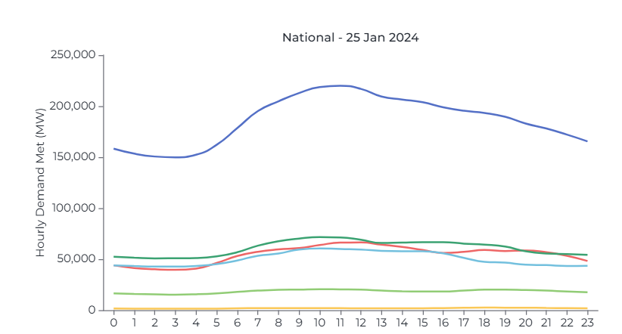
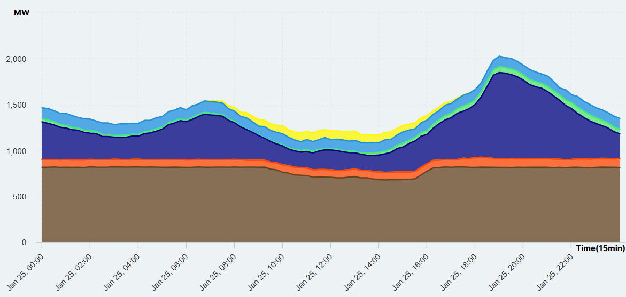

Typical load curve of India
Typical load curve of Sri Lanka
25 Jan 2024
Source: https://iced.niti.gov.in/energy/electricity/distribution/national-level-consumption/load-curve
Source: https://gendata.pucsl.gov.lk/generation-profile
Notes:
Here are the Indian and Sri Lankan load curves for a same day. You can sea that around 7am india load demand is increasing. That’s a one reason for the unavailability .

Slide 13
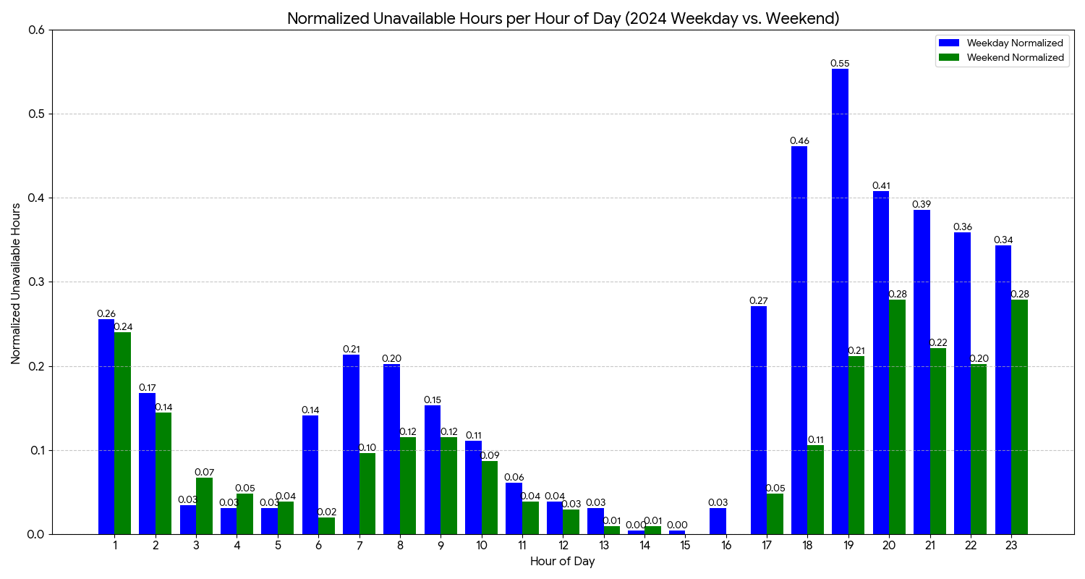
UNAVAILABLE PROBABILITY OF THE LINK:
Notes:
Here are the Indian and Sri Lankan load curves for a same day. You can sea that around 7am india load demand is increasing. That’s a one reason for the unavailability .

Slide 14
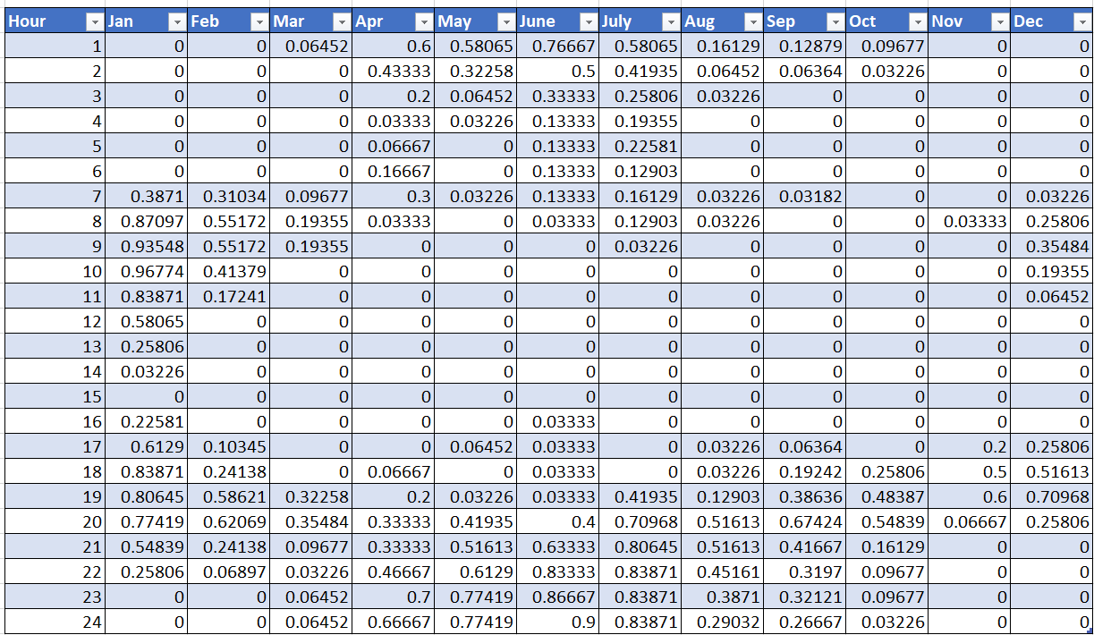
UNAVAILABLE PROBABILITY OF THE LINK:
Notes:
Here are the Indian and Sri Lankan load curves for a same day. You can sea that around 7am india load demand is increasing. That’s a one reason for the unavailability .

Slide 15
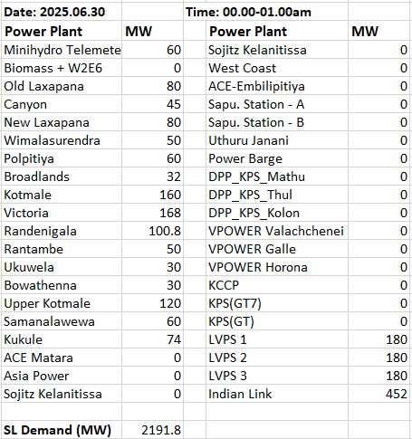

ECONOMICAL DISPATCH
Linear Programming Model
Every hour
Maximum and minimum power
Hydro plant availabilities

Slide 16
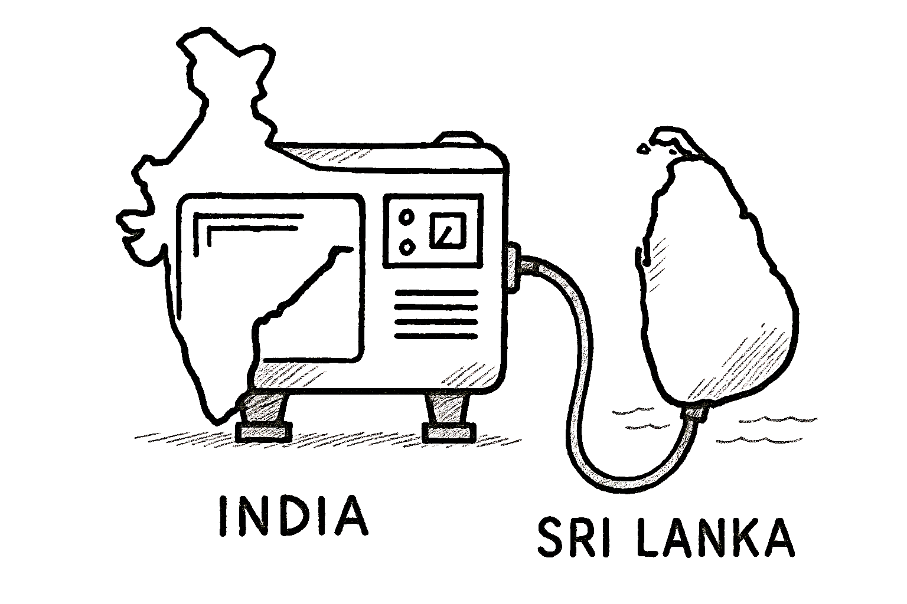
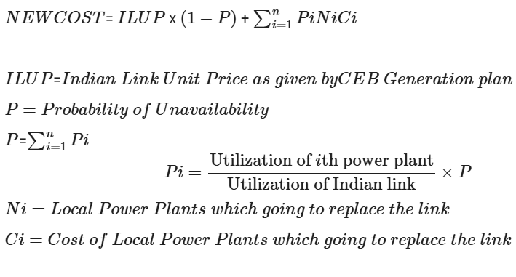
CALCULATIONS:
Notes:
Here are the Indian and Sri Lankan load curves for a same day. You can sea that around 7am india load demand is increasing. That’s a one reason for the unavailability .

Slide 17
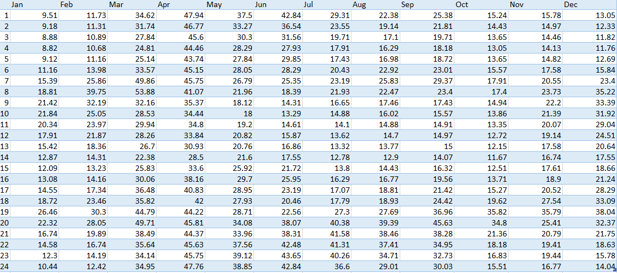
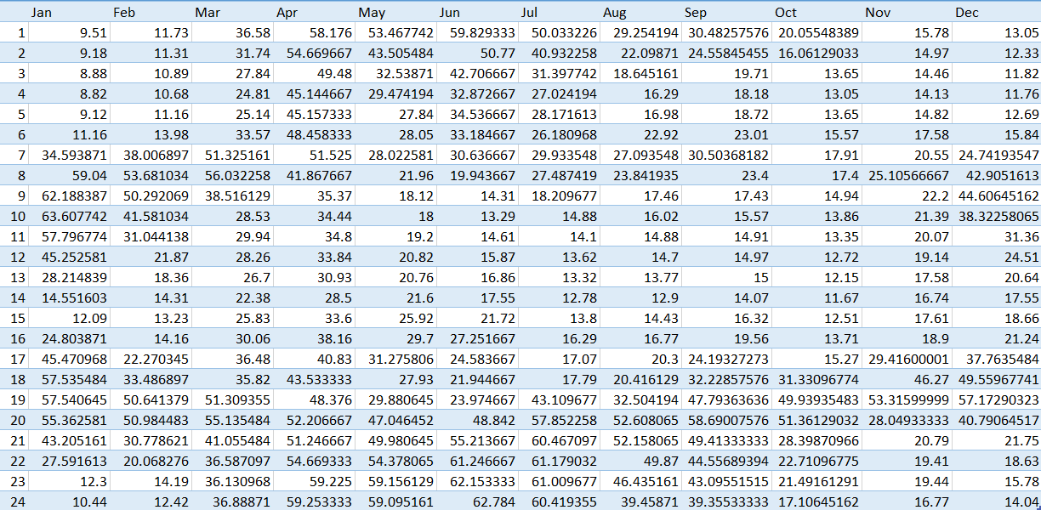
RESULTS
Updating the cost table for scenario 1: one with 350 MW of renewables (300 MW solar, 50 MW wind),With and Without Indian Link
Original Scenario
Scenario 1

Slide 18
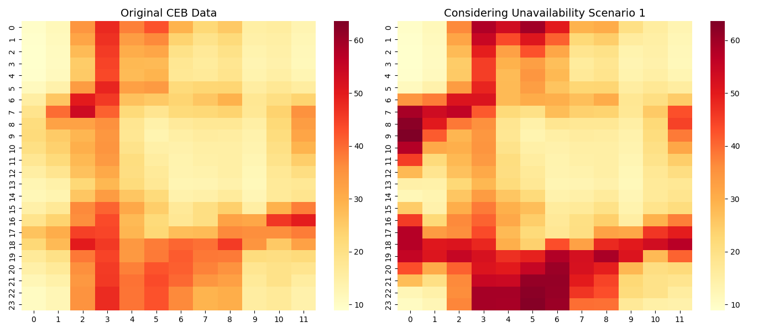
RESULTS:

Slide 19
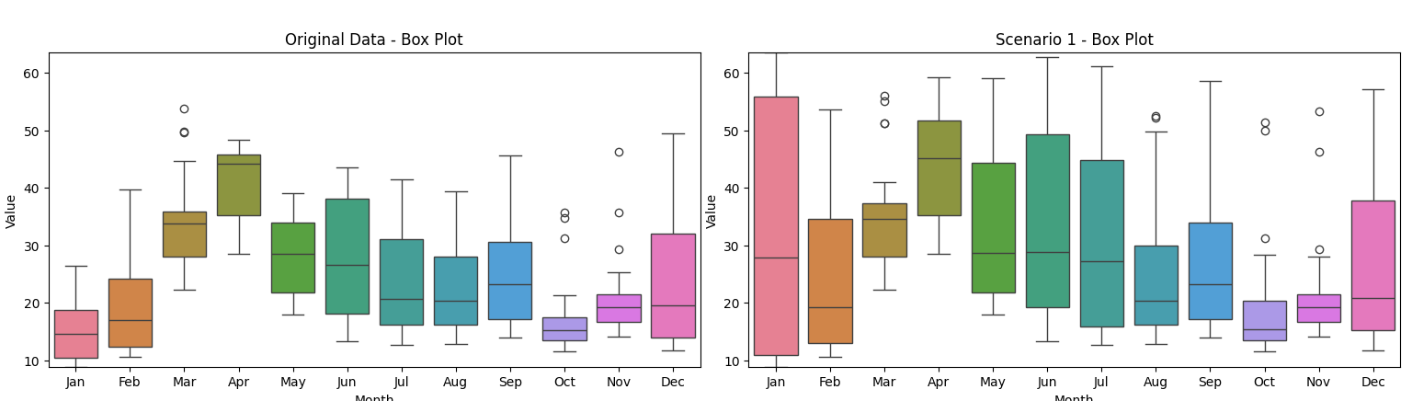
RESULTS:

Slide 20
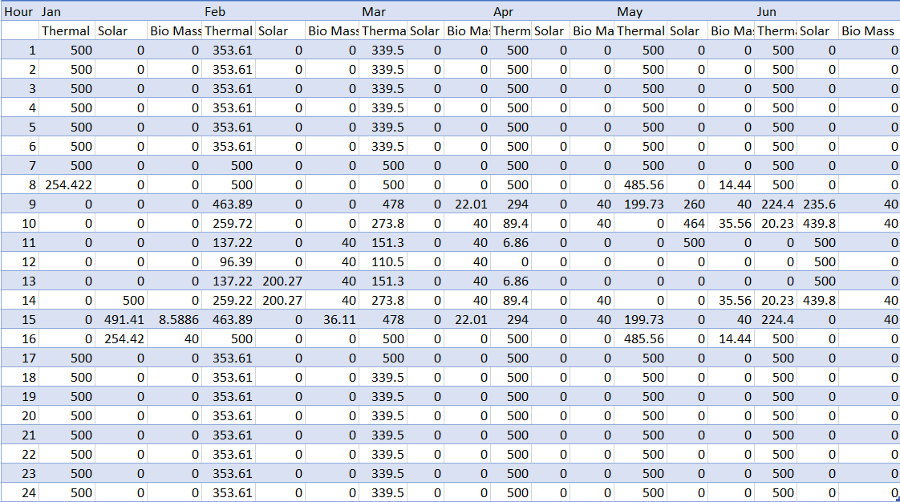
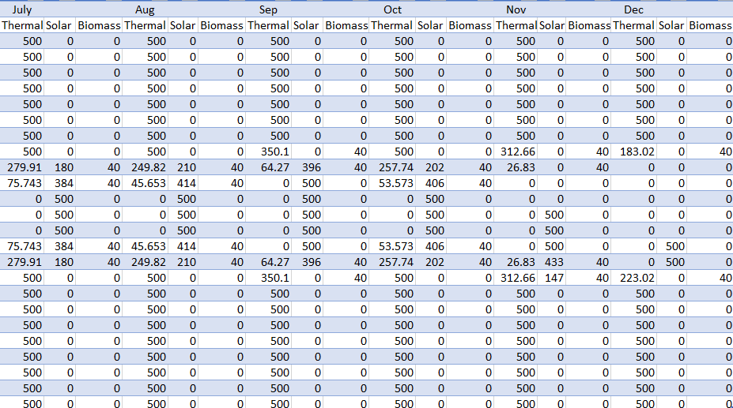
EFFECT ON LOCAL POWER PLANTS
From 5:00 p.m. to 7:00 a.m., several thermal power plants will be taken offline from the interconnection.
During daytime hours, the grid operator may dispatch power from the interconnection instead of solar due to its lower marginal cost.
Scenario 4: Cost with 70% RE in 2030 onward, with and without 500MW HVDC interconnection.

Slide 21
OTHER SCENARIOS
Scenario 1: Cost with 350 MW of renewables (300 MW solar, 50 MW wind),With and Without 500MW Interconnection
Scenario 2: Cost With 45% RE in 2030 onward, with and without 500MW HVDC interconnection.
Scenario 3: Cost with 60% RE from 2027 onwards, with and without 500MW HVDC interconnection.
Scenario 4: Cost with 70% RE in 2030 onward, with and without 500MW HVDC interconnection.
Scenario 5: Achieve 70% RE by 2030 and increase to 80% by 2044, With 1000 MW HVDC interconnection.
In conclusion, this project evaluates various scenarios to determine the new unit cost of the Indian link, factoring in the probability of unavailability. By analysing each scenario, the economic dispatch can be calculated, along with identifying which power plants are likely to be decommissioned due to this interconnection. Additionally, the study assesses the financial losses for local power plants and the potential profits for Sri Lanka. Furthermore, it examines how the electricity bill is expected to vary in the long term as a result of this interconnection.

Slide 22
THANK YOU..!
Notes:
THANK YIU

